Slide 1
Style board/PLM app
Jennifer Nelson

Slide 2
Project motivation
Project Checklist
Making a PLM (Product Management Lifecycle) web-app where designers can put in their designs, label with a SKU code, name, & extra details.
Can add multiple squares to add more designs and see all designs on one page to manage the collection.
Get input from the user on a web page
Make changes to the HTML and/or CSS using JavaScript
Use an event to trigger a change to a web page.
Add HTML elements to a web page using the DOM

Slide 3
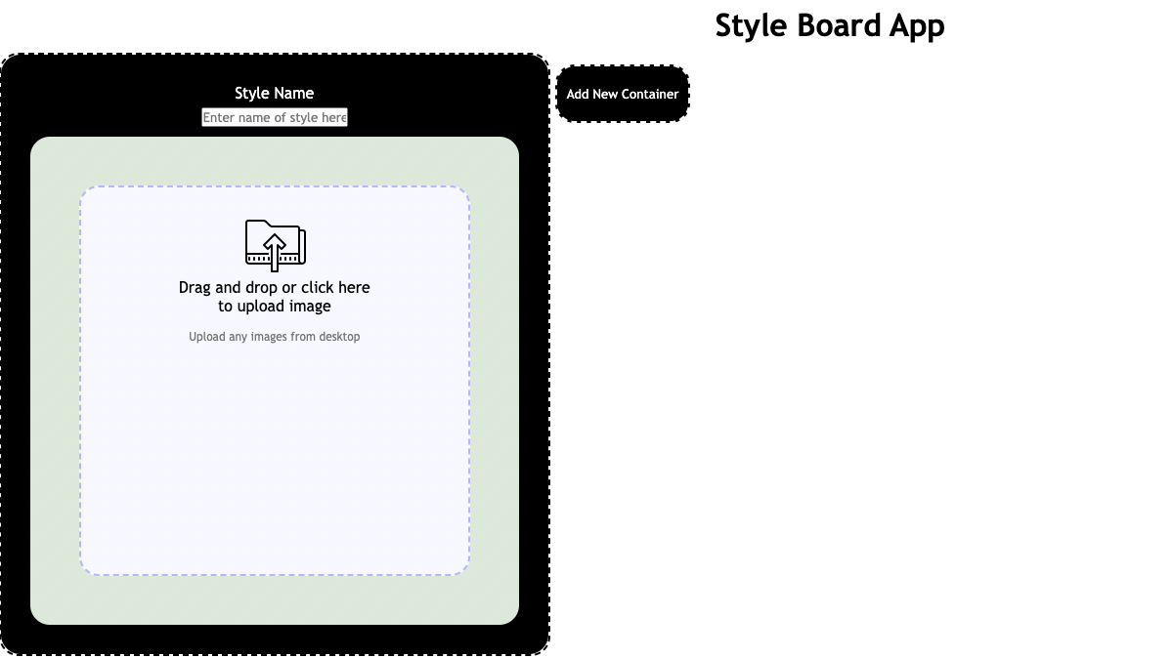
STYLE BOARD APP
Interface of simple Style Board App with function to add multiple containers to store information including text and images.

Slide 4
Additional Features
If you were to expand on the project, what additional features would you add?
I would like to add additional pages to sort style pages into different categories.
More information, input labels underneath for more details.
What would you have done differently if you had more time?
I would have changed placement of button and add minus button for removing containers.
Changed styling to be more cohesive.

Slide 5
Project general challenges
I found issues with the CSS as sometimes different CSS styles can clash and stop the code from running properly.
Learning experience and project experience
I would learn to plan the structure of the app and flow of information properly before starting on the project.
More integration of dynamic code within the project.

